Slide 1
Fake News Detection
Presented by:
Jainisha Choksi

Slide 2
Introduction
Fake News or hoax news is false or misleading information presented as news.
Fake news often has the aim of damaging the reputation of a person or entity, or making money through advertising revenue.
It is the problem of Text Classification as Fake and Real News.

Slide 3
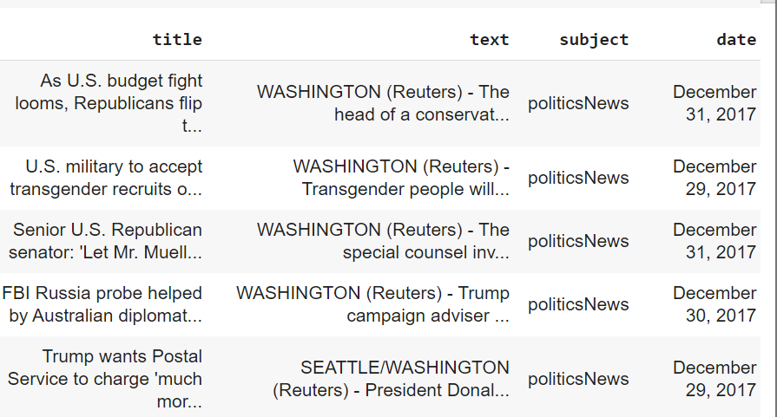
Dataset: True

Slide 4
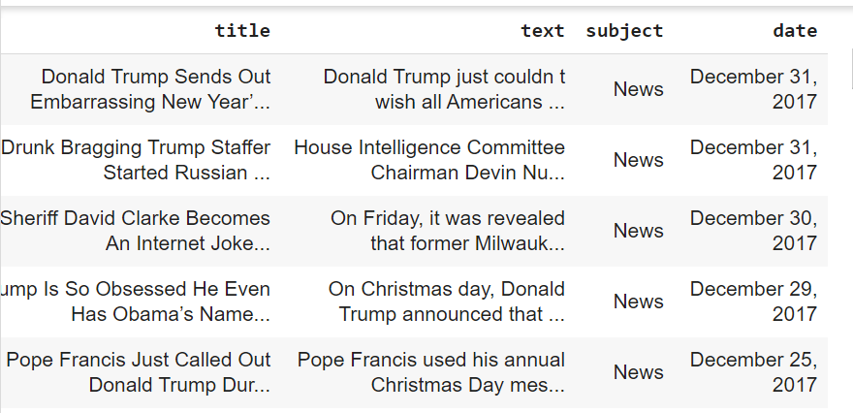
Dataset: False

Slide 5
Dataset
Here, we have 2 datasets as: True and False.
True has 21417 rows
False has 23481 rows
Class Imbalance problem - we create a new dataframe by merging both the datasets into 1 by taking 5000 rows from each by adding label column for the classification.

Slide 6
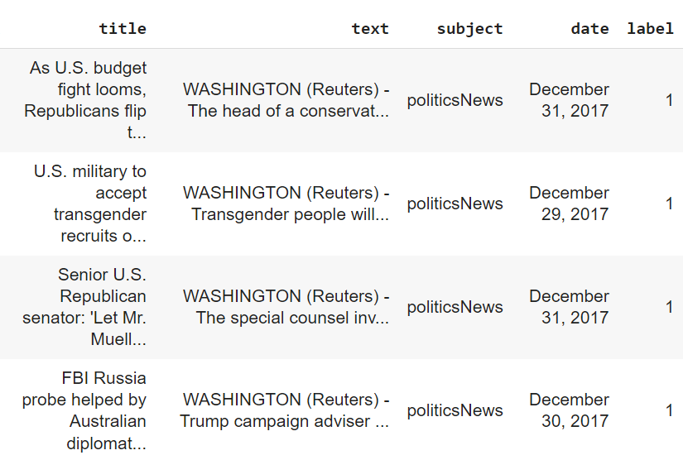
Dataset

Slide 7
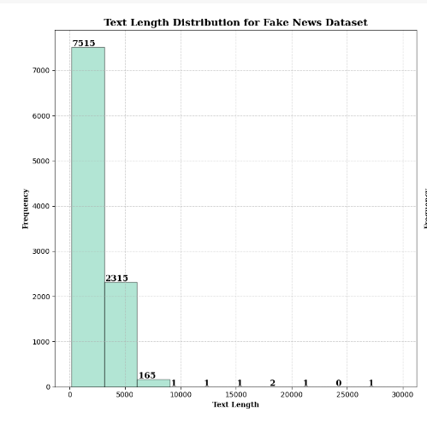
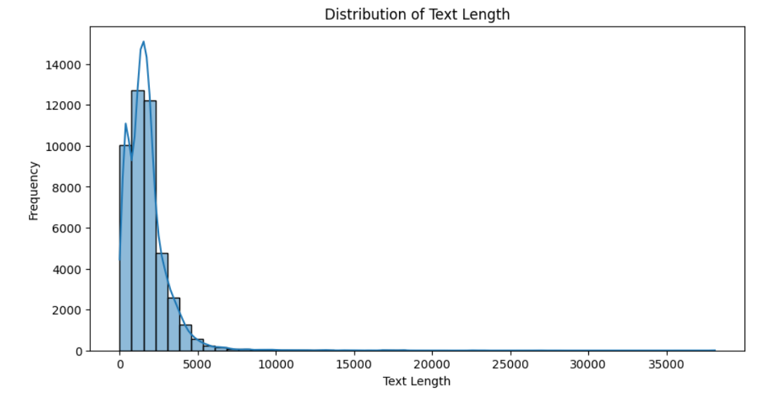
Exploratory Data Analysis

Slide 8
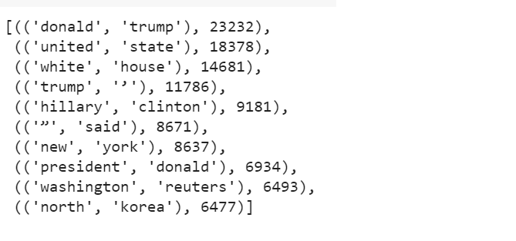
Exploratory Data Analysis

Slide 9
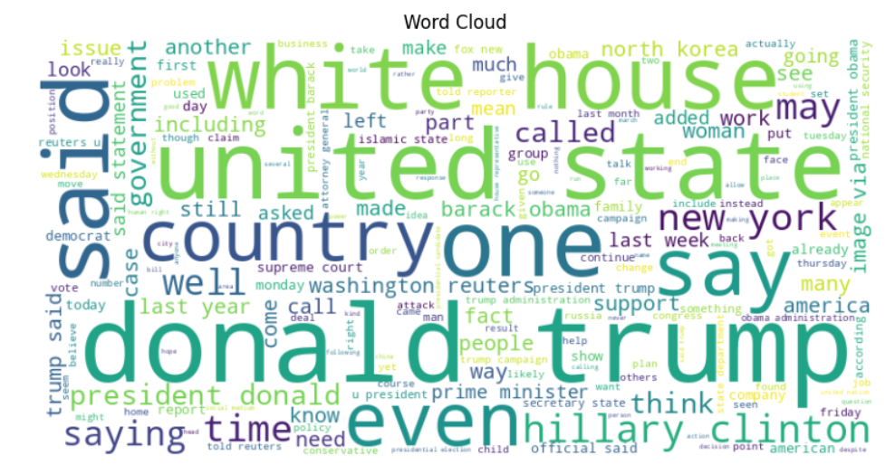
Exploratory Data Analysis

Slide 10
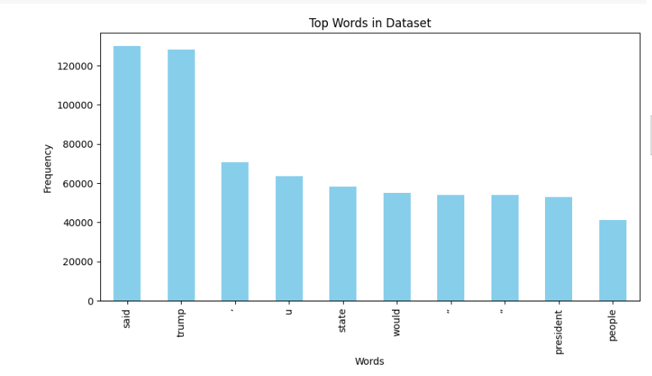
Exploratory Data Analysis

Slide 11
Data Preprocessing
Natural Language Preprocessing is used.
Convert to Lowercase
Splitting the words
Removing Stopwords
Performing Lemmatization
Join words as text

Slide 12
TF-IDF Vectorizer
TF-IDF Term Frequency Inverse Document Frequency
Increases proportionally to the number of times in the text a word appears but is compensated by the word frequency in the corpus.
Term Frequency:In document d, the frequency represents the number of instances of a given word t. The weight of a term that occurs in a document is simply proportional to the term frequency.
tf(t,d) = count of t in d/ number of words in d

Slide 13
Document Frequency
Similar to TF but in whole corpus collection.
df(t) = occurrence of t in documents
Inverse Document Frequency: IDF of the word is the number of documents in the corpus separated by the frequency of the text.
idf(t) = N/ df(t)
tf-idf(t,d) = tf(t,d) * idf(t)

Slide 14
Machine Learning Models
Random Forest:
Ensemble Learning Method - Ensemble of Decision Trees
Majority Votes as a combination Factor.

Slide 15
Machine Learning Models
Logistic Regression:
Binary Classification
Predict the probability of an article being fake or genuine
If p(fake) > 0.5 predict - Fake , otherwise - True

Slide 16
Machine Learning Models
SVM:
Support Vector Machines - classify by finding an optimal decision boundary
Hyperplane separates the data into different classes.
Hyperplane - A high dimensional line that separates the dataset into classes

Slide 17
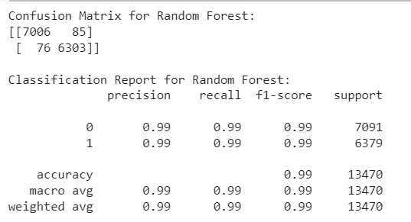
Confusion Matrix and Classification Report

Slide 18
Conclusion
Detecting and addressing fake news demands a holistic approach. By leveraging tech tools, promoting media literacy, and fostering partnerships, we can build a robust defense against misinformation.

Slide 19
Future Scope
Use of Advance Machine Learning Algorithm
Natural Language Processing Enhancements
Cross-platform Collaboration
Ethical AI Practices
Online Machine Learning
Public Awareness Campaigns

Slide 20
Thank You

